Slide 1

Working with screenshot in selenium

Slide 2
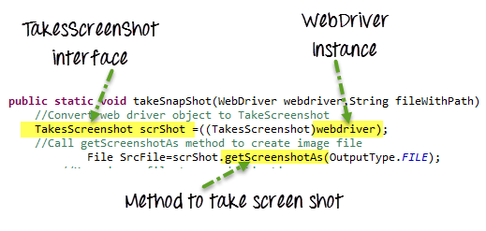
Introduction
Screenshot is an image of the data displayed on the screen of a computer .
Screenshots are desirable for bug analysis.
Selenium can automatically take screenshots during execution.

Slide 3
Procedure for taking Screenshot
Taking Screenshot in Selenium is a 3 Step :-
Step 1) Convert web driver object to TakeScreenshot.
Step 2) Call getScreenshotAs method to create image file.
Step 3) Copy file to Desired Location and save it as C:/Test.png
TakesScreenshot scrShot =((TakesScreenshot)webdriver);
File SrcFile=scrShot.getScreenshotAs(OutputType.FILE);

Slide 4
Now See the code here:-
package automationTakeScreenshot;
import java.io.File;
import org.apache.commons.io.FileUtils;
import org.openqa.selenium.OutputType;
import org.openqa.selenium.TakesScreenshot;
import org.openqa.selenium.WebDriver;
import org.openqa.selenium.firefox.FirefoxDriver;
import org.testng.annotations.Test;
public class TakeScreenshot {
@Test
public void testingTakeScreenShot() throws Exception{
WebDriver driver ;
System.setProperty("webdriver.firefox.marionette","C:\\geckodriver.exe");
driver = new FirefoxDriver();
//goto url
driver.get(URL);

Slide 5
//Call take screenshot function
this.takeSnapShot(driver, "c://test.png") ;
}
/**
* This function will take screenshot @param webdriver,@param fileWithPath and @throws Exception */
public static void takeSnapShot(WebDriver webdriver,String fileWithPath) throws Exception{
//Convert web driver object to TakeScreenshot
TakesScreenshot scrShot =((TakesScreenshot)webdriver);
//Call getScreenshotAs method to create image file
File SrcFile=scrShot.getScreenshotAs(OutputType.FILE);
//Move image file to new destination
File DestFile=new File(fileWithPath);
//Copy file at destination
FileUtils.copyFile(SrcFile, DestFile);
}
}

Slide 6
Covered Till Now
Screenshot is an image of the data displayed on the screen of a computer .
Screenshots are desirable for bug analysis.
Selenium can automatically take screenshots during execution.

Slide 7
Thanks

